Slide 1
Service Area Boundaries and EJ Paper
Internal/deliberative
8/2/24

Slide 2
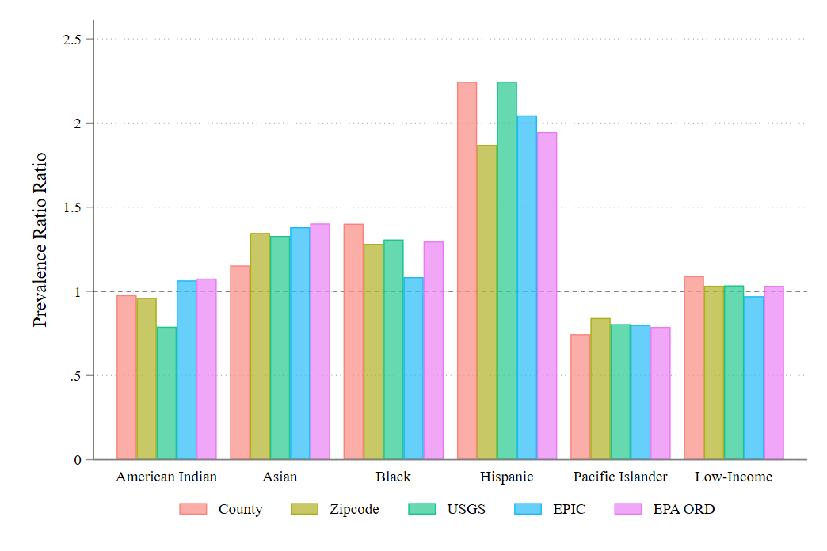
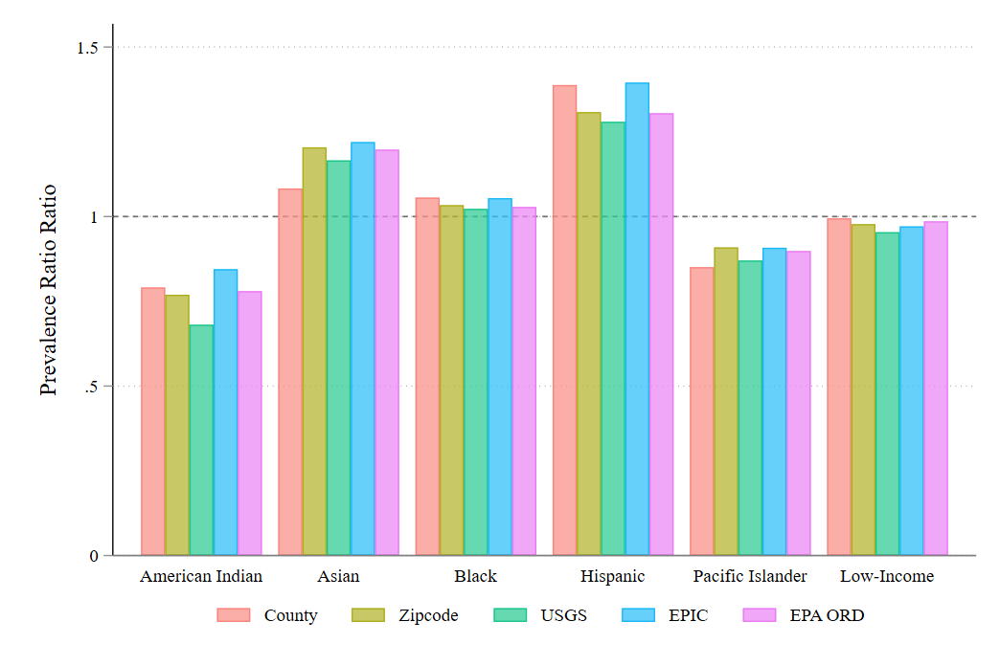
PFAS Measures – Sum of Averages
Sum of Average Concentrations
Count of Unique PFAS

Slide 3
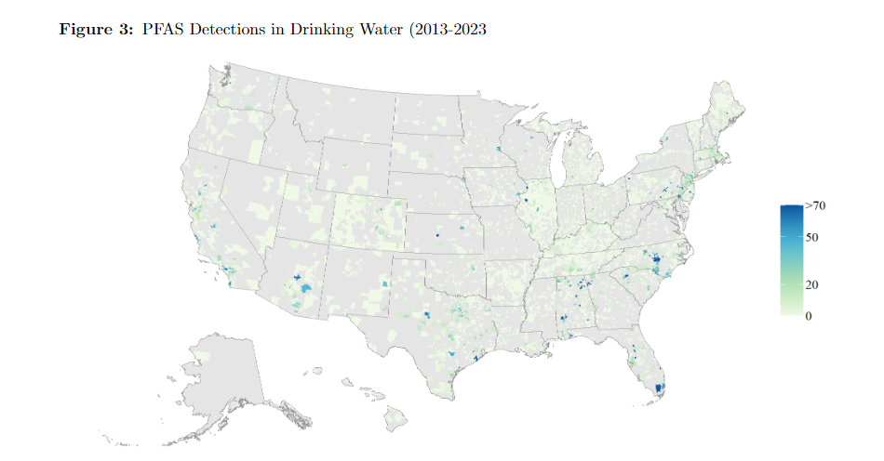
PFAS Measures – Sum of Averages

Slide 4
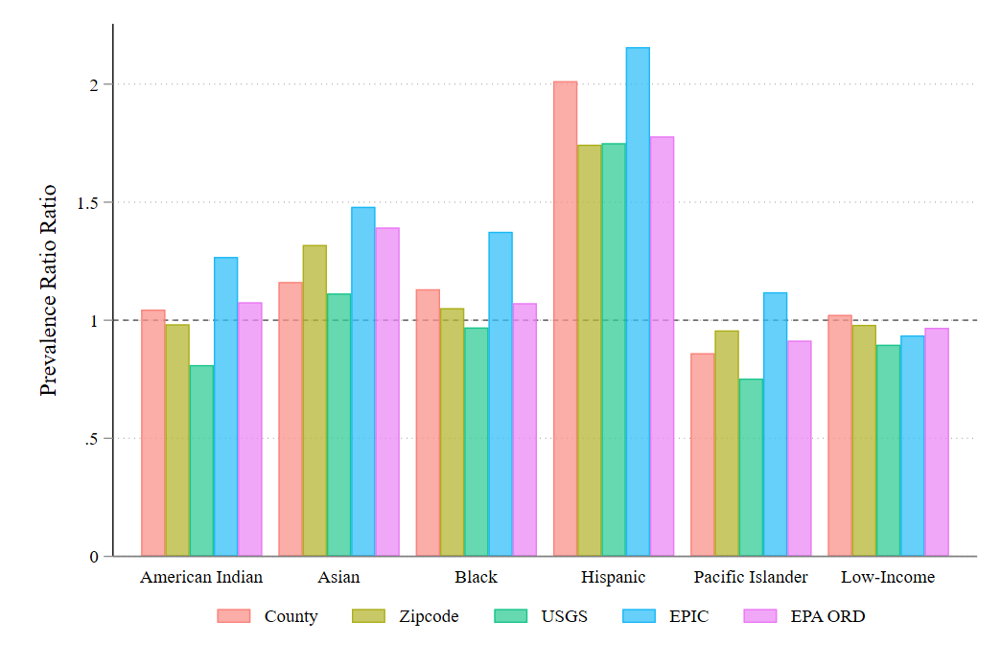
PFAS Measures – Sum of Maximums
Sum of Max Concentrations
Count of Unique PFAS

Slide 5
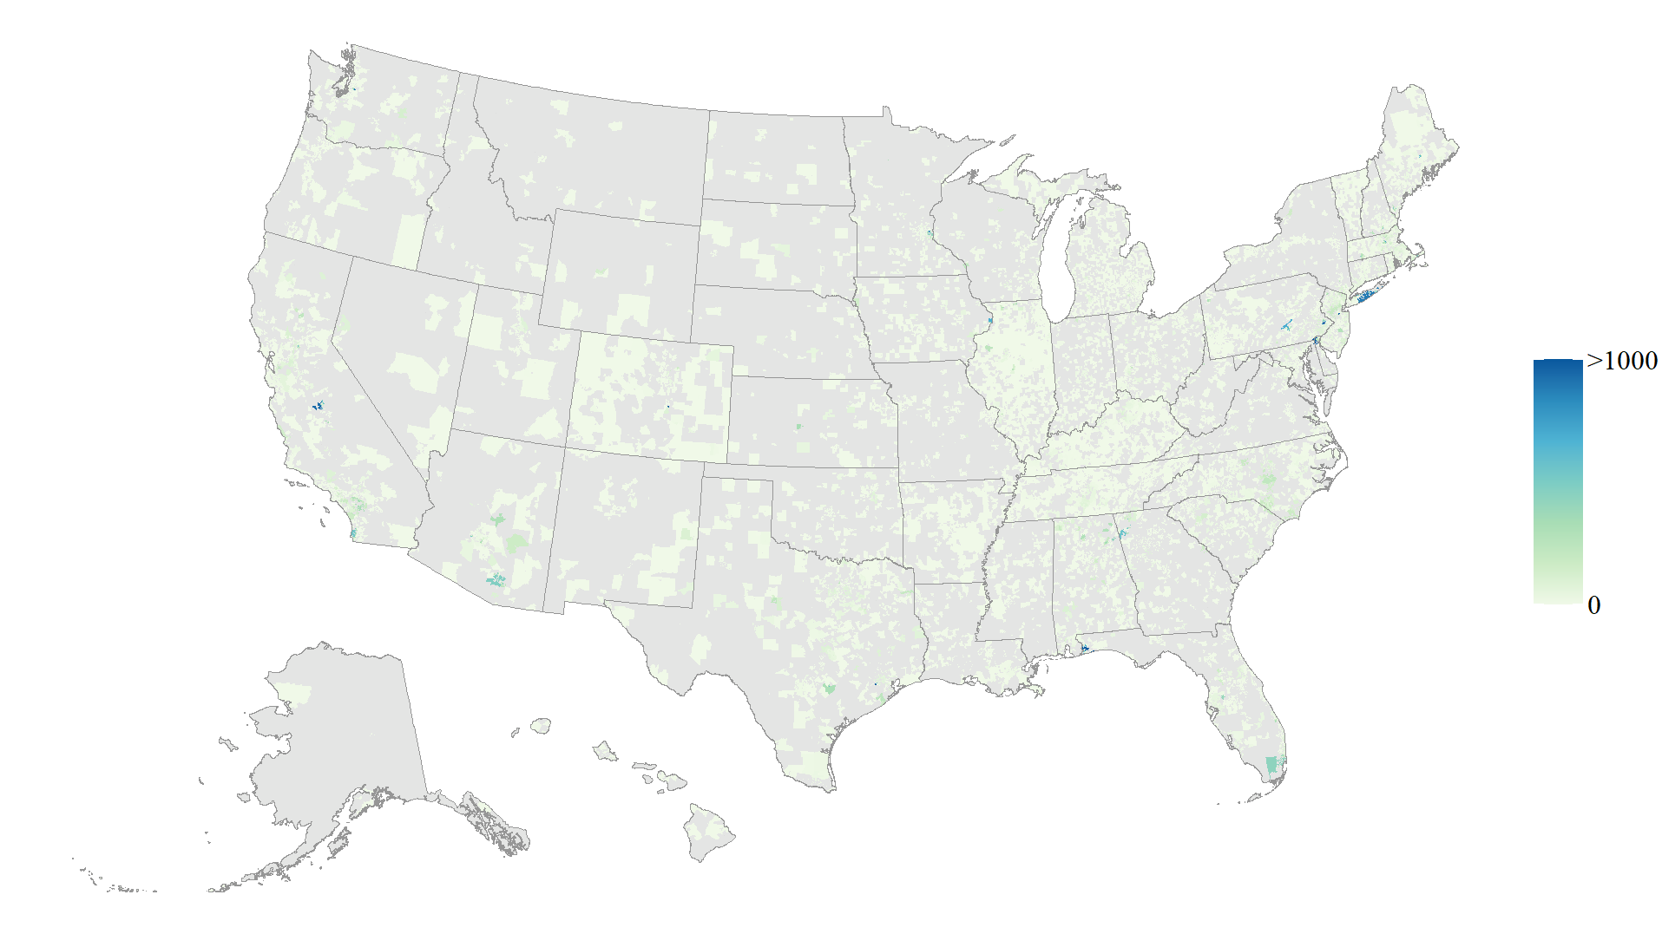
PFAS Measures – Sum of Maximums

Slide 6
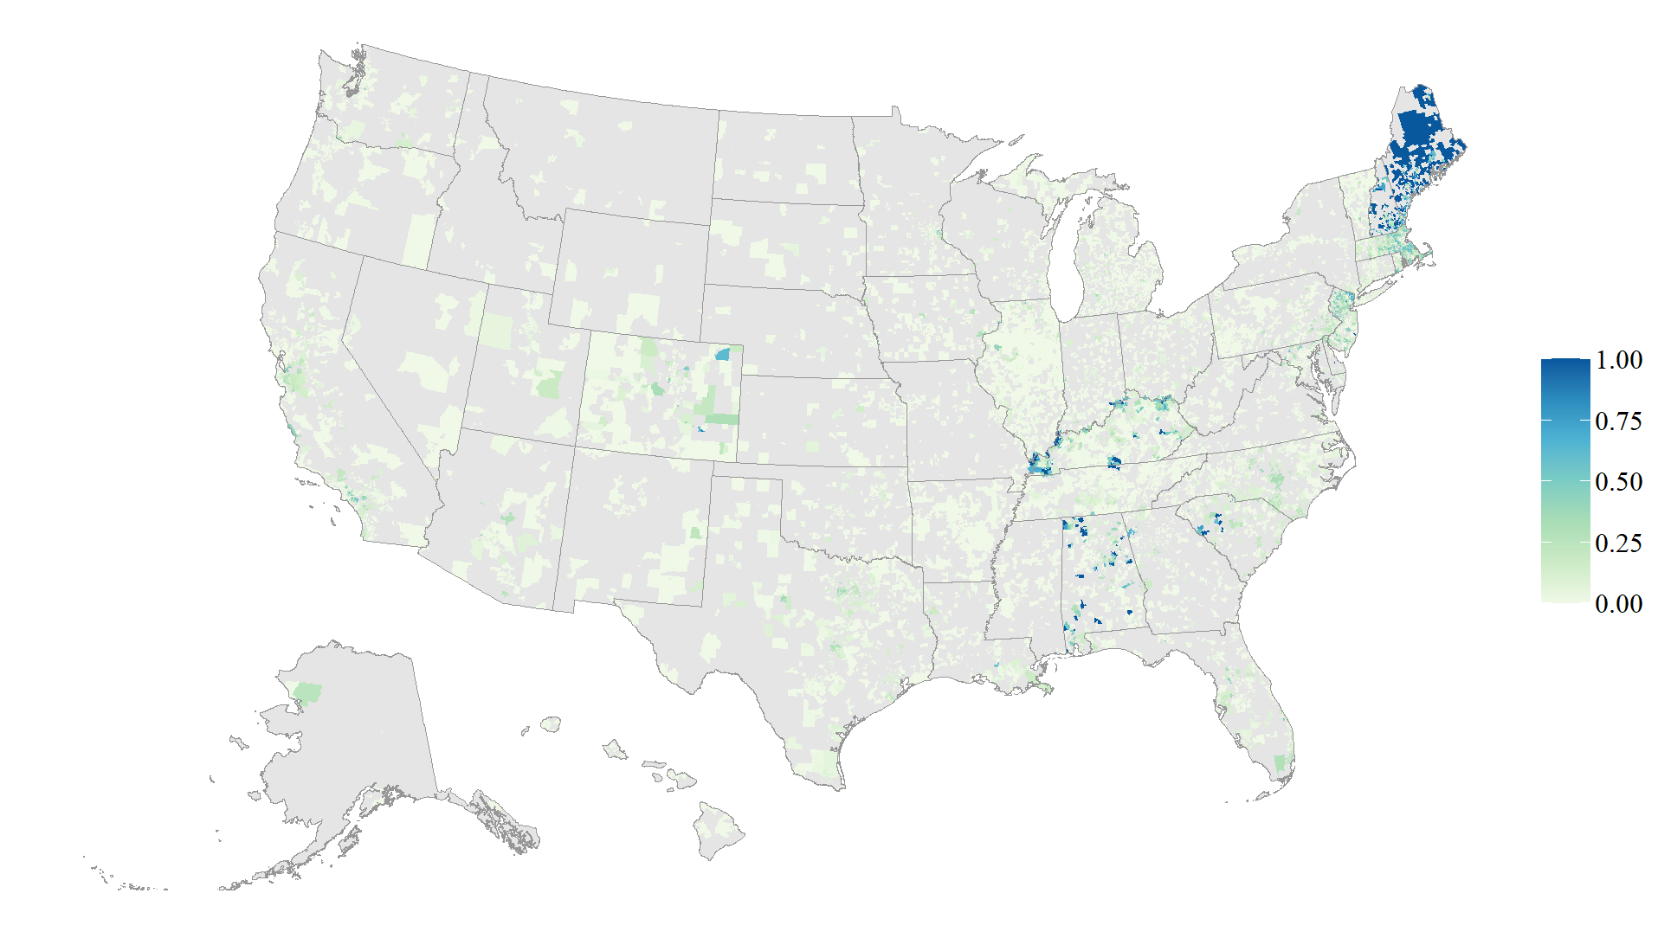
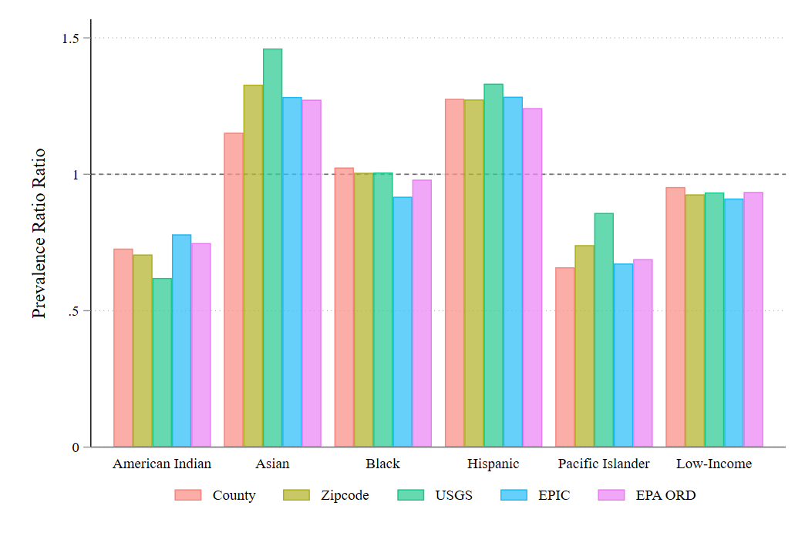
PFAS Measures – Detection Share

Slide 7
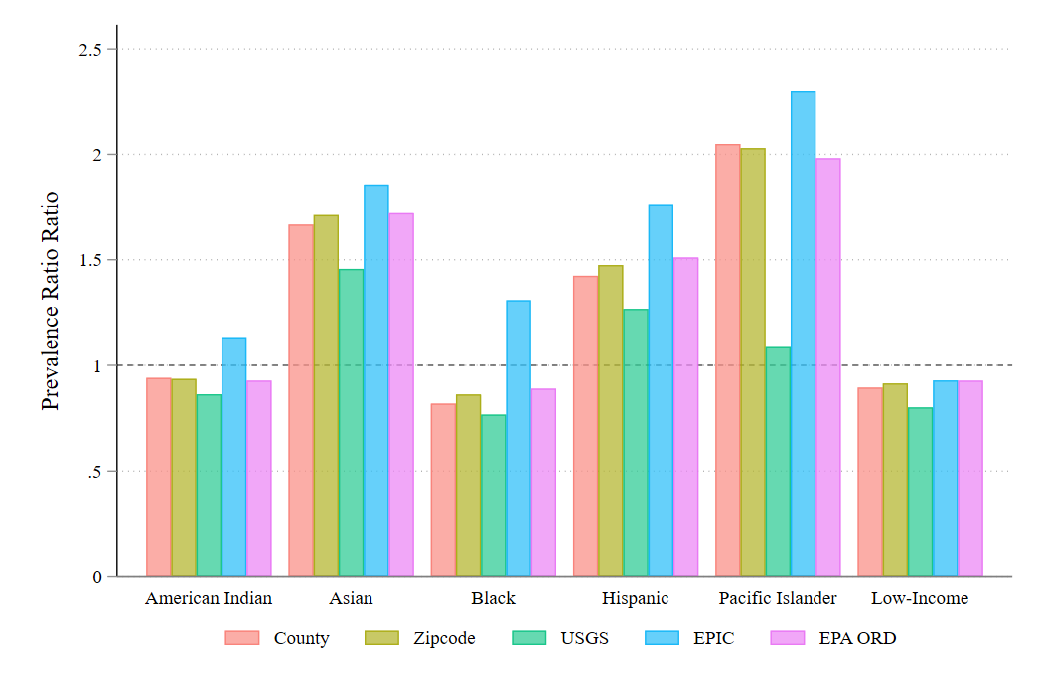
PFAS Measures – Total Samples per System

Slide 8
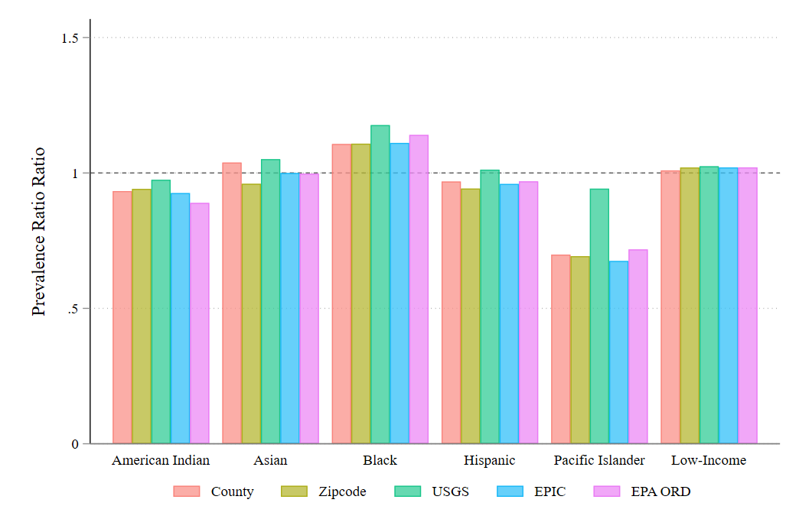
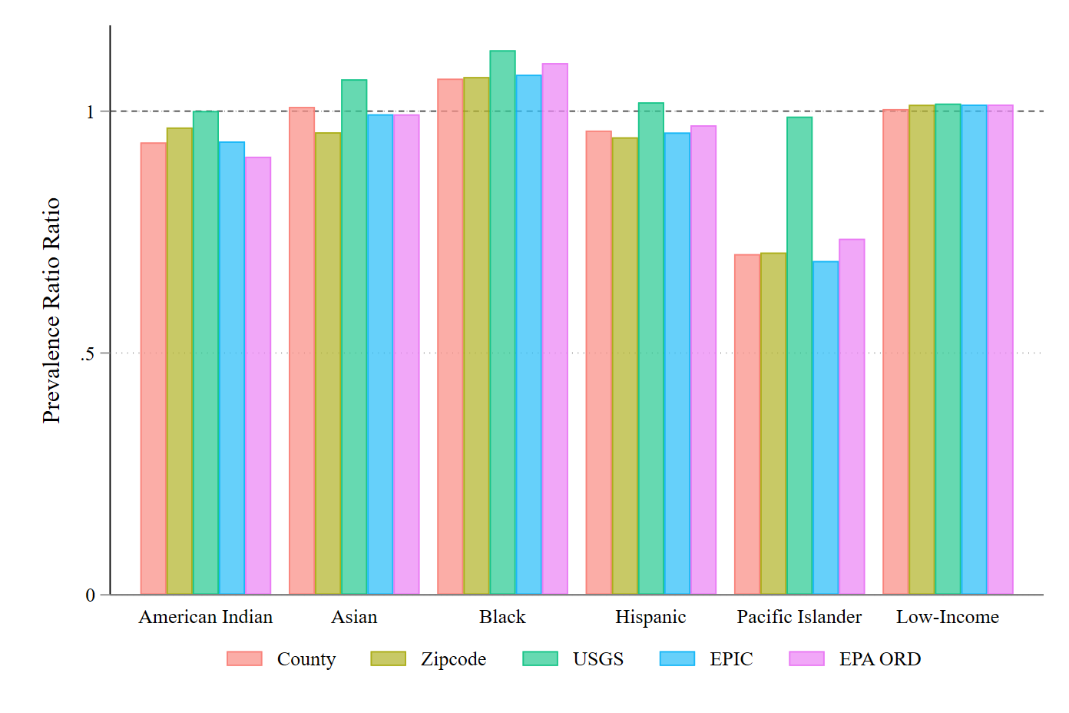
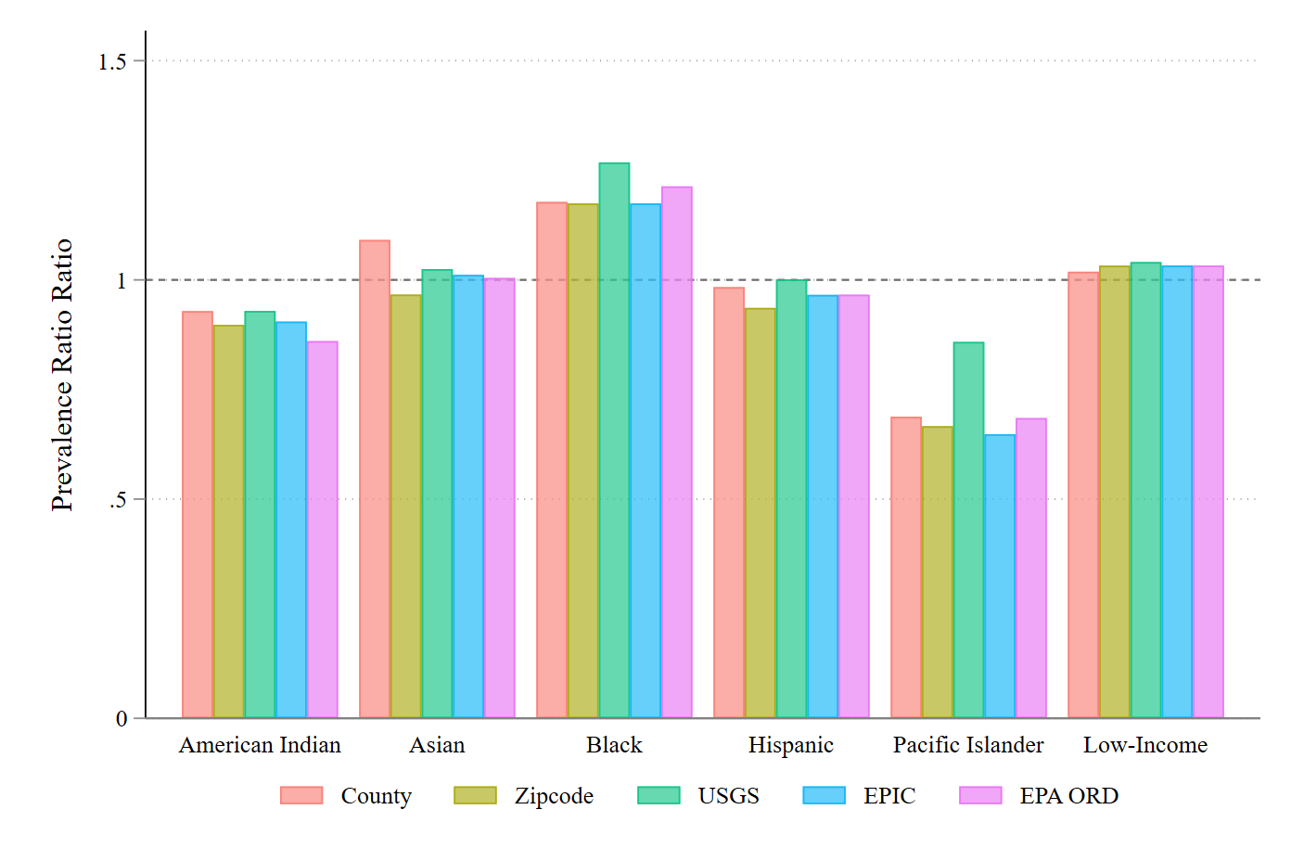
TTHM vs. Haloacetic Acids
Combined
TTHM
Haa5

Slide 9
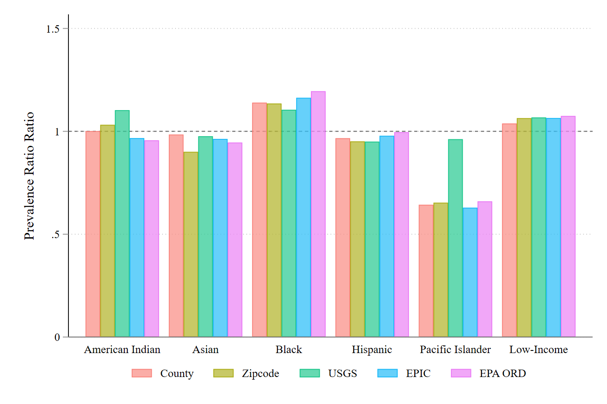
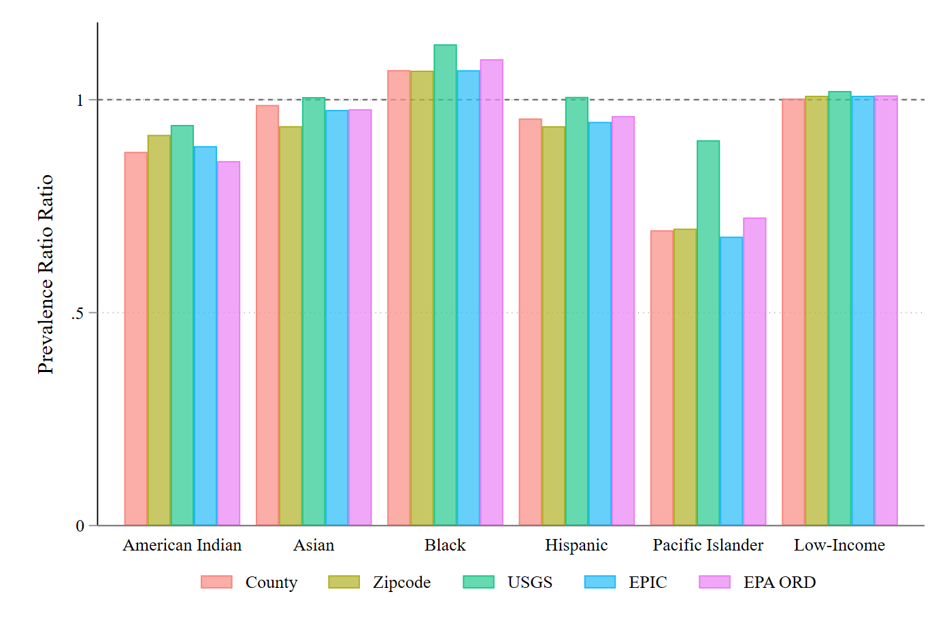
TTHM in SYR3 vs. SYR4
SYR3
SYR4

Slide 10
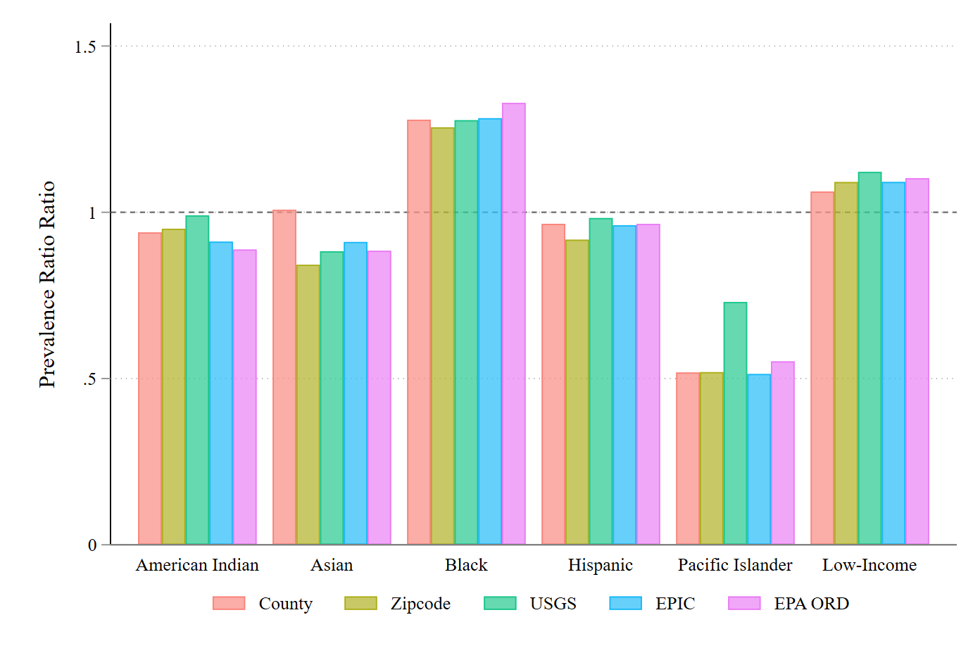
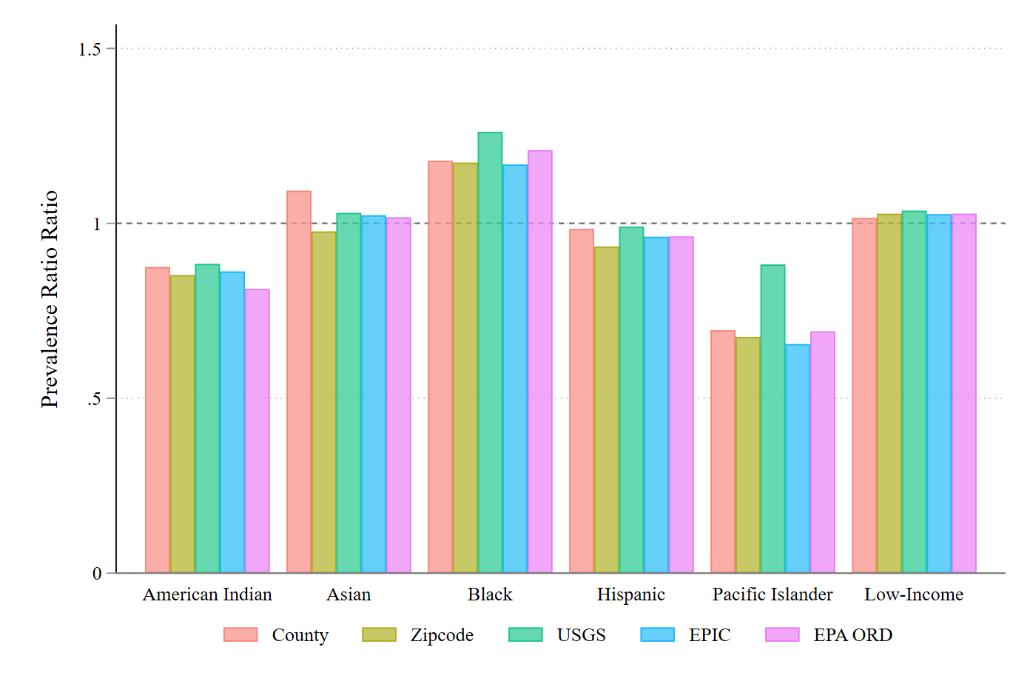
HAA5 in SYR3 vs. SYR4
SYR3
SYR4

Slide 11
What to put in appendix?
Main Table | Appendix
Figures 1 – 7: Indicator maps and prevalence ratios | F1: race and demographics
Figures 8 – 14: Bivariate maps for all indicators | F2: New Jersey aggregation
Figure 15: Oklahoma visual comparison bivariate map | F3: Missing systems and health based violations
F16: Ohio lead ALEs, New Jersey PFAS, and NC DBPs | F4: percent low income by SAB
F17: estimated percent minority across SABs | F5 – F9: specific demographic group shares by SAB
T1: summary statistics of indicators by SAB | T1: PRs for just tier 1 and tier 2
T2: indicators by demographic group | T2: PRs for just tier 2 and tier 3
T3: basic PRs by Sab type | T3: five high quality states
T4: Demographic Regression (EPIC boundaries) | T4: RR by race and ethnicity for just county, EPIC, and ORD
T5: Cumulative Burden Regression (EPIC boundaries) | T5: summary statistics when removing zeroes
 | T6: Demographic Regression (ORD boundaries)
 | T7: Cumulative Burden Regression (ORD boundaries)
 | T8: Demographic Regression (county boundaries)
 | T9: Cumulative Burden Regression (county boundaries)

Slide 12
Next Steps
Double-checking code is updated
Move all in-text edits over to the Overleaf file
Edit Overleaf file to address all non-controversial comment bubbles
Incorporate latest H&M boundary data and demographic info throughout paper: all maps, regression tables, relative risk figures, all tables
Incorporate DBP measures
Rename relative risk throughout
PFAS sensitivity table plus one for PFOA+PFOS
Address Michael Goldberg comments
Decide what to put in appendix
New pfas sensitivity test removing 2013-2017 method 537 samples

